Slide 1
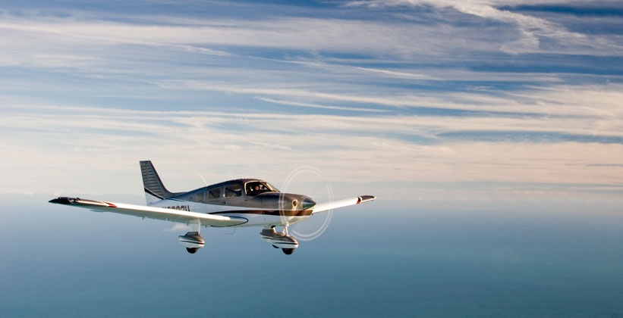
Crosswind Circuits

Slide 2
Housekeeping
60 minutes
Emergency exit, toilet, kitchen

Slide 3
Aim
To learn the correct techniques for taxiing, take-off, flying a circuit pattern and landing the aeroplane in crosswind conditions.

Slide 4
Motivation
Wind does not always exactly align with the runway direction, which means there will be a crosswind component.
Incorrect technique can damage the aeroplane as well as its occupants and cargo.
Notes:
It is very important that you understand and are able to apply the correct techniques at all phase of flight, especially during landing when it is most critical.
It is especially important to stay ahead of the aeroplane.

Slide 5
Overview
Objectives
Revision
Definitions
Determining the crosswind
Crosswind limitations
Application
Airmanship & TEM
Summary
Objectives- revisited

Slide 6
Objectives
At the end of the briefing, you will be able to, from memory and without mistake:
State the maximum demonstrated crosswind component for the PA28.
Describe the procedure, including the control column position, for a crosswind take-off.
Describe how would you adjust the turn onto final if you were experiencing a tailwind on base.
Describe the cross-control technique when landing in a right crosswind.

Slide 7
Revision
How wind affect turn radius
When should we go around
Flapless approach

Slide 8
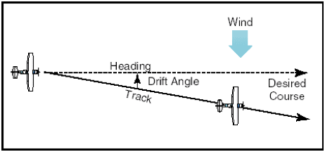
Definitions
Heading
The direction in which the nose of the aeroplane is pointing with reference to the magnetic compass.
Track
The path which the aeroplane actually travels over the ground.

Slide 9
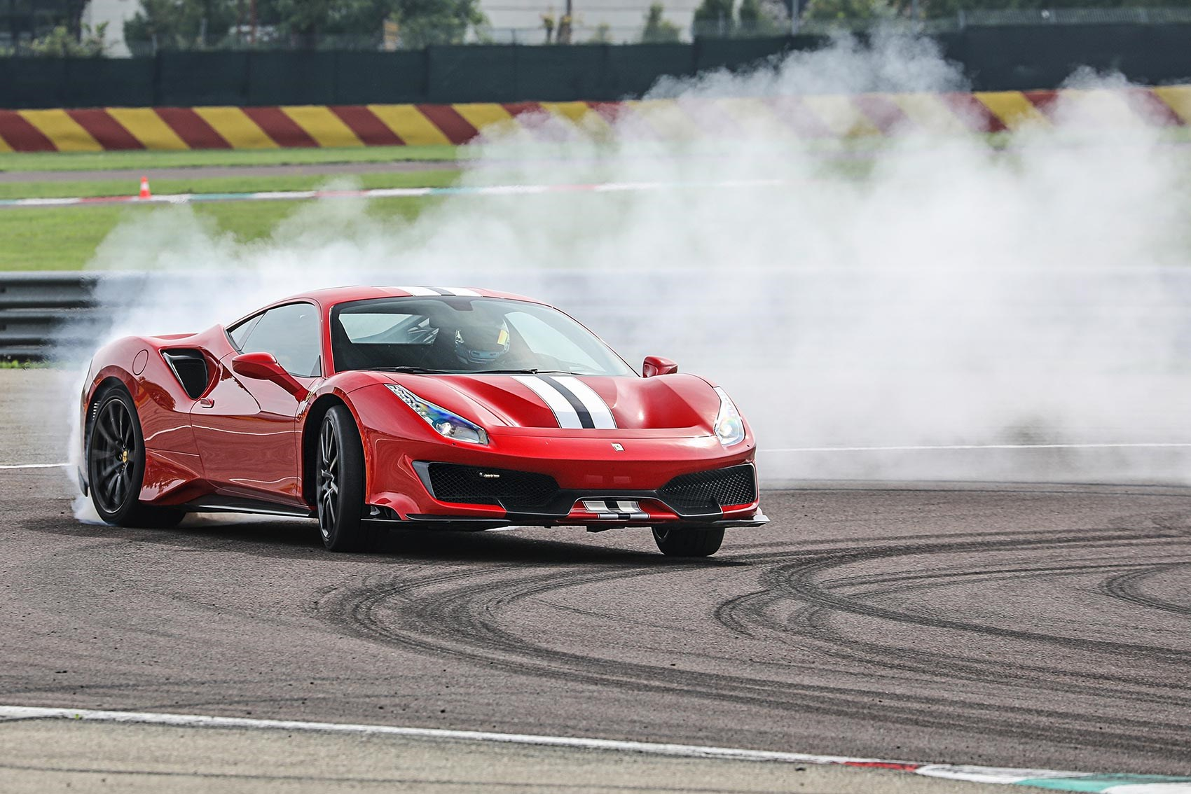
Definitions
Drift
The angular difference between the aeroplane’s heading and track. Also known as the crab angle.

Slide 10
Definitions
Wind angle
The angular difference between the aeroplane’s heading and the wind.

Slide 11
Definitions
Demonstrated crosswind component
Is the highest crosswind component in which it has been shown that is possible to safely land an aeroplane by a test pilot.

Slide 12
Definitions
Weathercock
The tendency of an aeroplane’s nose to turn in the direction of the wind.

Slide 13
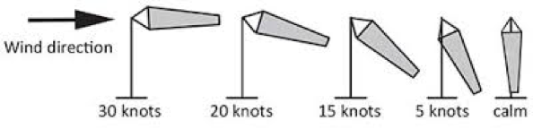
Determining the crosswind
There are various sources to obtain the wind direction and velocity, which include:
TAF Terminal Aerodrome Forecast
TTF Trend Type Forecast
METAR Aviation routine report, issued at fixed times
ATIS Automatic Terminal Information Service
AWIS Aerodrome Weather Information Service
Windsock Visible Indicator

Slide 14
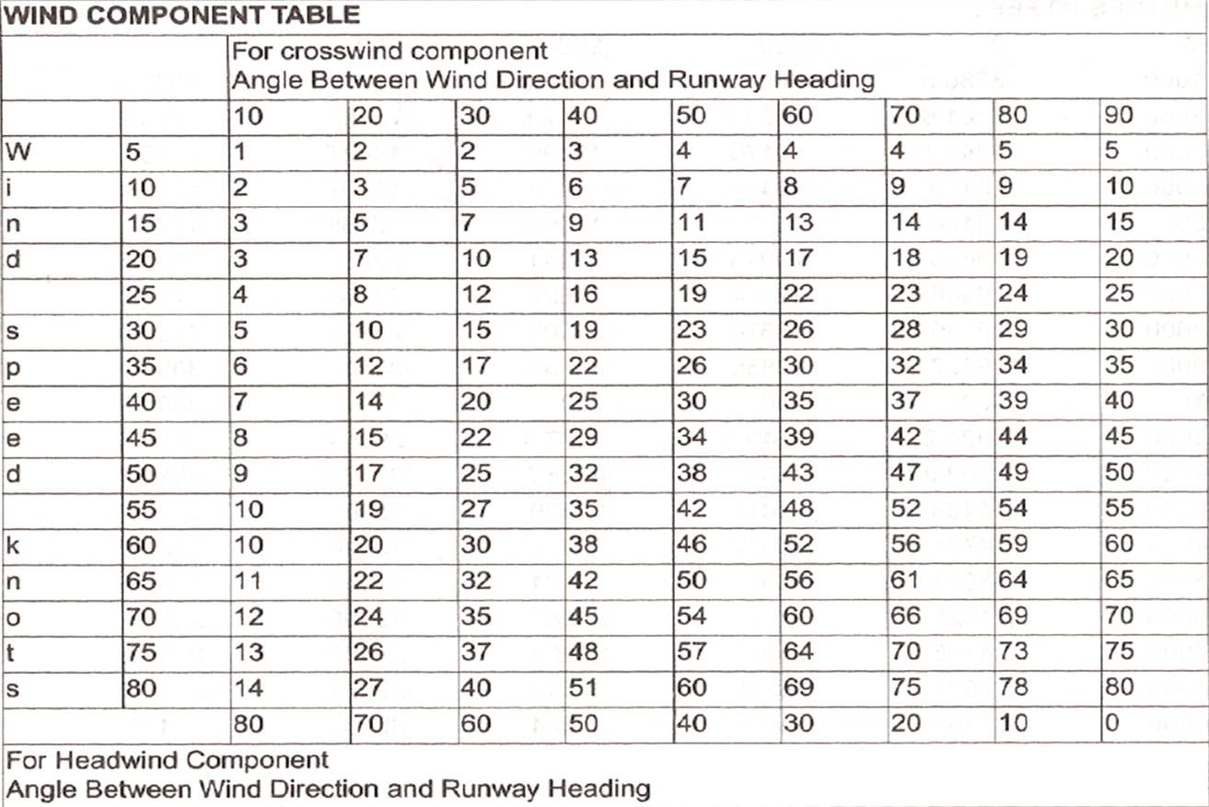
Determining the crosswind
Use ERSA wind table
Wind 320/20
RWY29 in use
Wind 230/35
RWY29 in use
Notes:
Impractical in flight

Slide 15
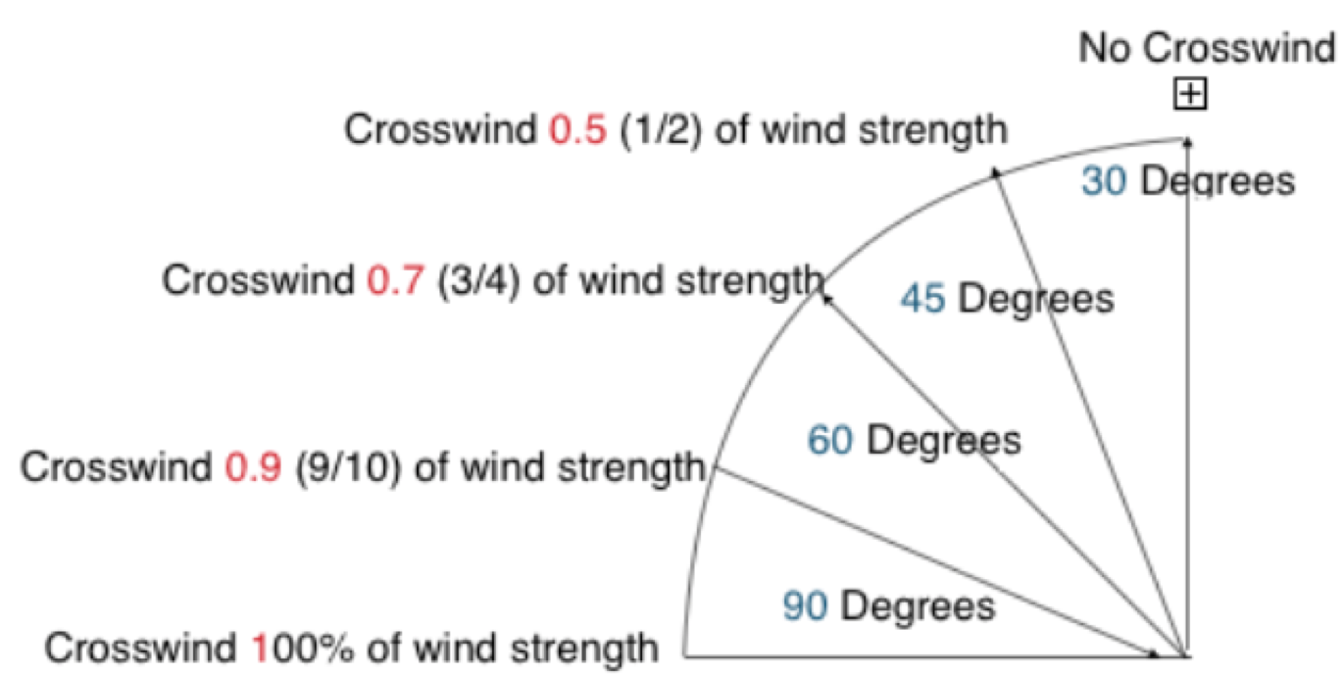
Determining the crosswind
Rule of thumb
Wind 310/20
RWY29 in use
Wind 230/35
RWY29 in use

Slide 16
Crosswind limitations
Can be found in the aeroplane’s QRH GREEN section.
17 kts for both Warrior and Archer.
Consider your own limitation
Notes:
Max demonstrated crosswind is the most crosswind component of which a test pilot has landed the aeroplane safely during test flight. It is not design limit of the aeroplane.

Slide 17
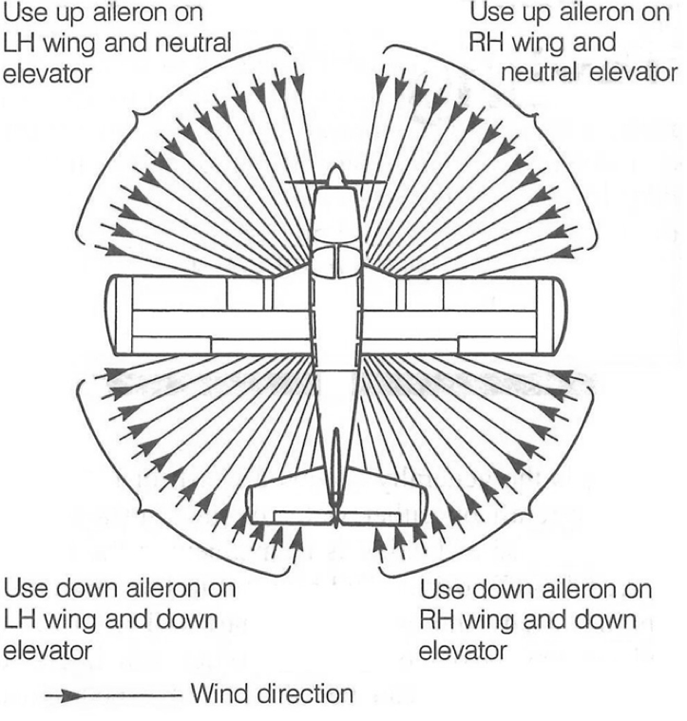
Application – Taxi
Notes:
Fuselage blocks part of the airflow over the downwind wing. The upwind wing will experience a faster relative airflow thus generating more lift.

Slide 18
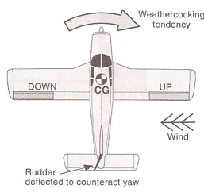
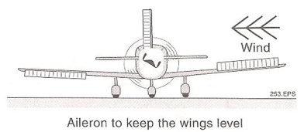
Application – Take-off roll
Use aileron to keep wings level. Full deflection into wind from stationary, slowly towards neutral position at V_{R.}

Slide 19
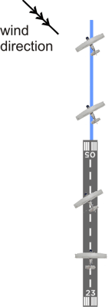
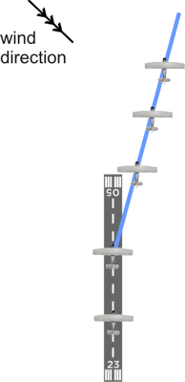
Application – Upwind
Compensate the drift
Maintain extended centreline
Notes:
Select a slightly left of original reference point to crab and allow for the crosswind.

Slide 20
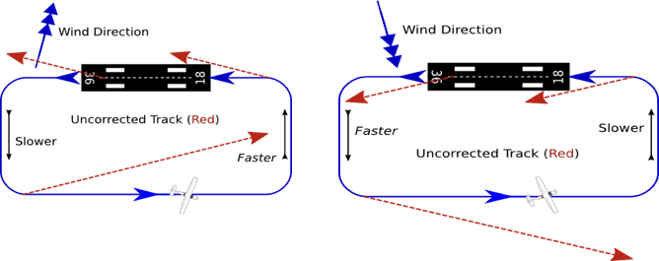
Application – Crosswind circuits
Notes:
We experience headwind on crosswind, if maintain 15 AOB, turn radius decreasing and downwind will be too close to runway. Delay the turn.
We experience tailwind on crosswind, if maintain 15 AOB, turn radius increasing and downwind will be too far from runway. Turn earlier or increase AOB.
Overshoot, undershoot.

Slide 21
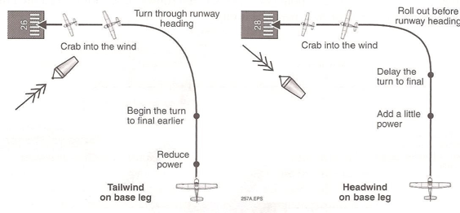
Application – Turn onto final
Notes:
If you overshoot the runway, do not use rudder to increase the rate of turn. Already at low airspeed and large AOB will increase stall speed.

Slide 22
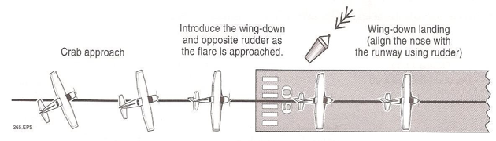
Application – Final approach
Initially crab the aircraft to maintain extended centreline
At flare height over the threshold, apply aileron into wind, use opposite rudder to keep aircraft straight.
We will be landing with the upwind gear first. Exercise caution as a wing strike may be possible.
Notes:
Landing sideways will overstress the tyre and landing gear, causing a flat tyre, as well as causing a skid tyre and subsequent loss of control.

Slide 23
Airmanship
Know your aeroplane’s limitation and your personal limitation.
Anticipate turns and adjust for wind effects
Use of flaps

Slide 24
Threat and error management
Threat | Error | Management | UAS
Traffic |  | Good lookout | Air proximity event
Gusty conditions | Incorrect control input | Good technique
Poor lookout
Loss of control

Slide 25
Summary
Determining the crosswind
How to deal with crosswind

Slide 26
Objectives – revisited
State the maximum demonstrated crosswind component for the PA28.
Describe the procedure, including the control column position, for a crosswind take-off.
Describe how would you adjust the turn onto final if you were experiencing a tailwind on base.
Describe the cross-control technique when landing in a right crosswind.

Slide 27
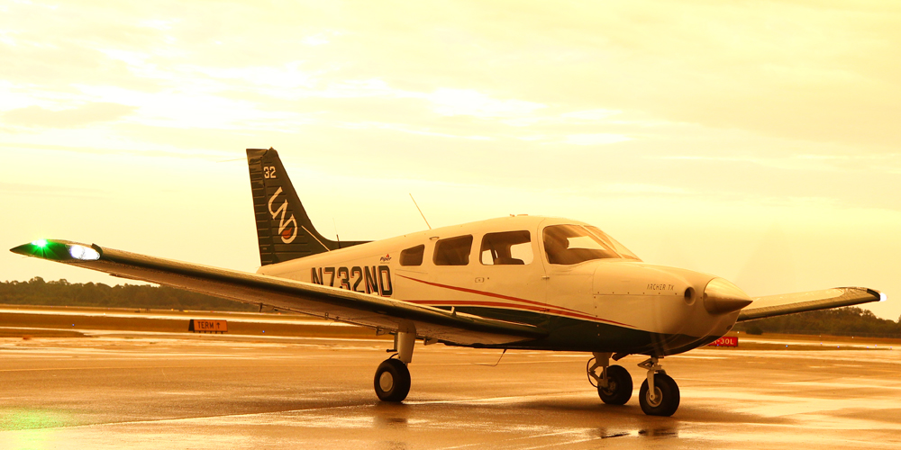
The End

